Slide 1
Listen Up! Barometer
2-Day Data Collection Start-Up Meeting
[Location]
[Date]
[Organization(s)]

Slide 2
Welcome!

Slide 3
Meeting Outcomes
By the end of the 2 days, participants will have:
  An understanding of the Listen Up! Project and the Barometer
  An understanding of the purpose and use of all data collection tools and an agreed upon understanding of collecting data aligned with feminist principles
  Group agreements on roles, responsibilities, safety, security and best practices

Slide 4
Overview: Agenda
What is the Listen Up! Project and Barometer?
Review of gender-based violence (GBV) core concepts, guiding principles and survivor-centered support
Terminology and language
Basics of feminist data collection
Data collection: review and practice of the tools
Ethical and safety considerations and security
Roles and responsibilities of each Barometer team member
Group Agreements and Code of Conduct
Review of the GBV referral pathways and contacts
Review of key humanitarian documents

Slide 5
What is the Listen Up! Project and Barometer?

Slide 6
Overview
Listen Up! Project
Barometer: What is it? What is its purpose?
Minimum standards that have guided the Barometer development
Theory of Change
Who is the Barometer for and when do we use it?
How do we measure a humanitarian response using the Barometer?
Notes:
See 0a. Introduction to the Listen Up! Barometer document for more information

Slide 7
The Listen Up! Project History
Project goal: Amplify the voices and power of refugee and host community women and girls to catalyze institutional reform, interagency action, and increased resources with the goal of reducing sexual harassment, exploitation and abuse (SHEA) of women and girls in humanitarian settings.
Listen Up! implemented across different contexts in collaboration with women’s rights organizations under three objectives.
Under objective 1, Listen Up! aims to establish an Index that measures action to address GBV and SHEA prevention and response in humanitarian contexts.
Listen Up! is guided by feminist principles, including the belief that the humanitarian system needs to fundamentally transform to truly prevent SHEA of women and girls affected by crisis and women at work in emergencies.
Notes:
See 0a. Introduction to the Listen Up! Barometer document for more information.
We believe that the humanitarian system needs to fundamentally transform if we are to truly prevent sexual exploitation, abuse and harassment of women and girls affected by crisis and women at work in emergencies.

Slide 8
The Listen Up! Barometer
A planning and assessment tool that examines the lived experiences of women and girls to determine if the environment of a humanitarian emergency response is able to prevent, mitigate and respond to GBV, sexual exploitation and abuse, and sexual harassment.
A rapid assessment of strengths and weaknesses of a humanitarian response for women and girls, including those working within humanitarian emergencies and those in the catchment area of an emergency response, for the purpose of creating recommendations for advocacy.
An advocacy tool for women’s groups, organizations and networks, and other GBV actors, to hold those responsible for humanitarian responses accountable to women and girls.
Notes:
See 0a.Introduction to the Listen Up! Barometer document for more information.

Slide 9
Minimum standards
This Barometer was developed based on existing minimum standards around prevention of and response to GBV, sexual harassment, and sexual exploitation and abuse. These minimum standards are established global inter-agency best practices. They include:
  Interagency GBV Minimum Standards for Gender-Based Violence Programming in Emergencies
  IASC Guidelines for Integrating GBV Interventions in Humanitarian Action
  Prevention of Sexual Exploitation and Abuse Minimum Operating Standards
  IASC Best Practice Guide Inter-Agency Community-Based Complaints Mechanisms
  GBV Accountability Framework
Notes:
See 0a. Introduction to the Listen Up! Barometer document for more information.

Slide 10
Theory of Change
VISION | Women and girls affected by crisis and women at work in emergencies pursue their potential, free from violence and inequality.
OUTCOMES | 1. Women and girls trust and access safe, confidential, accountable support services when they experience GBV, including sexual harassment, exploitation and abuse. | 2. Women and girls have equal access and control over humanitarian services and resources. | Humanitarians use power positively and respect and value women and girls.
 |  |  | 3. The humanitarian system prioritizes, resources and values efforts to address sexual harassment, exploitation and abuse | 4. Humanitarian organizations hold staff accountable to address sexual harassment, exploitation and abuse
Notes:
See 0a. Introduction to the Listen Up! Barometer document for more information on the Theory of Change, its four outcome areas, and each pathway of change.

Slide 11
Who is the Barometer for and when do we use it?
Who is it for?
Women’s right actors, groups, organizations and networks at the national, local, community and grassroots levels
Working in partnership with a GBV humanitarian actor
When to use it?
Whenever women and girls and allies within the humanitarian system are concerned that humanitarian action is harming women and girls, and/or that there is insufficient humanitarian action to ensure safe and equitable access to humanitarian aid for women and girls.
It can be used on a one-off basis or periodically to ethically document women’s and girls’ lived experiences in a humanitarian response, for use in advocacy with humanitarian leadership, donors and humanitarian actors.
Notes:
See 0a. Introduction to the Listen Up! Barometer document for more information.

Slide 12
How do we measure a humanitarian response using the Barometer?
The Barometer uses 4 data collection tools and guides to collect data you will use to score the humanitarian response:
Focus Group Discussion (FGD) Guide: Discussions with women and girls
Key Informant Interview (KII) Guide: Interviews with local women’s groups, organizations and networks
Observational Checklist: A checklist that observes (1) documents on GBV and prevention of sexual exploitation, abuse and sexual harassment, and (2) the humanitarian response environment.
Staff Perception Survey: A survey for humanitarian workers (female and male)
Notes:
See Section 2. Implementation document for more information.

Slide 13
How do we measure a humanitarian response with the Barometer?
The Barometer assesses 4 areas of a humanitarian response that correspond with the 4 outcomes of the Theory of Change.
The Barometer uses a “traffic light system” (Red, Orange, Yellow, Green) to score the status of a GBV and prevention of sexual harassment and sexual exploitation and abuse humanitarian response across those 4 areas (from the Observational Checklist and Staff Perception Survey). It also draws from qualitative, narrative data to add nuance and detail to those scores (from FGDs and KIIs).
Each humanitarian emergency assessed with this Barometer will be given an overall score and individual scores for each outcome area.
Overall rating scores
91-100%
Strong achievement of all criteria; represents good practice and a strong ability of the humanitarian aid environment to prevent and respond to GBV, including sexual exploitation and abuse and sexual harassment; exceeds minimum standards
67-90%
Satisfactory achievement across most criteria; represents demonstration of ability to prevent and respond to GBV, including sexual exploitation and abuse and sexual harassment; meets minimum standards
51-66%
Limited achievement across most criteria; demonstrates some ability to prevent and respond to GBV, including sexual exploitation and abuse and sexual harassment; improvements needed to ensure minimum standards are met
0-50%
Insufficient achievement across the criteria; humanitarian aid environment not adequately preventing and responding to GBV, including sexual exploitation and abuse and sexual harassment; clear strategic planning is necessary to improve policy and practice; below minimum standards
Notes:
See 0a. Introduction to the Listen Up! Barometer document for more information.

Slide 14
Review of GBV core concepts, guiding principles, and survivor-centered support

Slide 15

ROOT CAUSES of GBV
Inequality between men and women across all aspects of life
Male abuse of control and POWER OVER women and girls
Lack of belief in human rights for all, that women’s and girls’ lives are less valuable than those of men and boys
Men’s position of power, privilege and entitlement over women
ROOT CAUSES
Patriarchy

Slide 16
Core types of GBV
Sexual Assault
Rape
Physical Assault
Denial of resources, opportunities or services
Forced Marriage/ Harmful Traditional Practices
Psychological/ Emotional Abuse
FORMS/TYPES

Slide 17
CONTRIBUTING FACTORS of GBV
EXACEBATING FACTORS
Alcohol/ drug abuse
Poverty
Collapse of traditional society and family support system
Religious, cultural and/or family beliefs and practices
Lack of police protection; lack of laws protecting against GBV
Availability of food, fuel, income generation
Conflict
Boredom and lack of services, activities or programs
Impunity
Loss of male power/ role in family and community
Men seeking to assert power
Retaliation
Tool/ strategy of war
Lack of education
Leadership predominantly male
Breakdown of social structures
For more examples of contributing factors see: IASC Guidelines for Integrated Gender-based Violence Interventions in Humanitarian Action (2015)

Slide 18
CONSEQUENCES OF GBV
Physical
Psychological
Social
Depression
Anxiety, fear
Self-blame
Shame
Self-hate
Suicidal thoughts
Impact on children
PTSD
Isolation
Family breakdown
Social rejection/ ostracization
Social stigma
Withdrawal from social life
Rejection/ ostracization from family
Death
Suicide
Serious injuries
Injuries during pregnancy
Unwanted or early pregnancy
STIs, incl. HIV/AIDs
Unsafe abortion complications
Vulnerability to disease
Acute or chronic illness
Infant mortality
EFFECTS/CONSQUENCES

Slide 19

1. Tree of oppression of women and girls
2. Tree of empowerment for women and girls

Slide 20
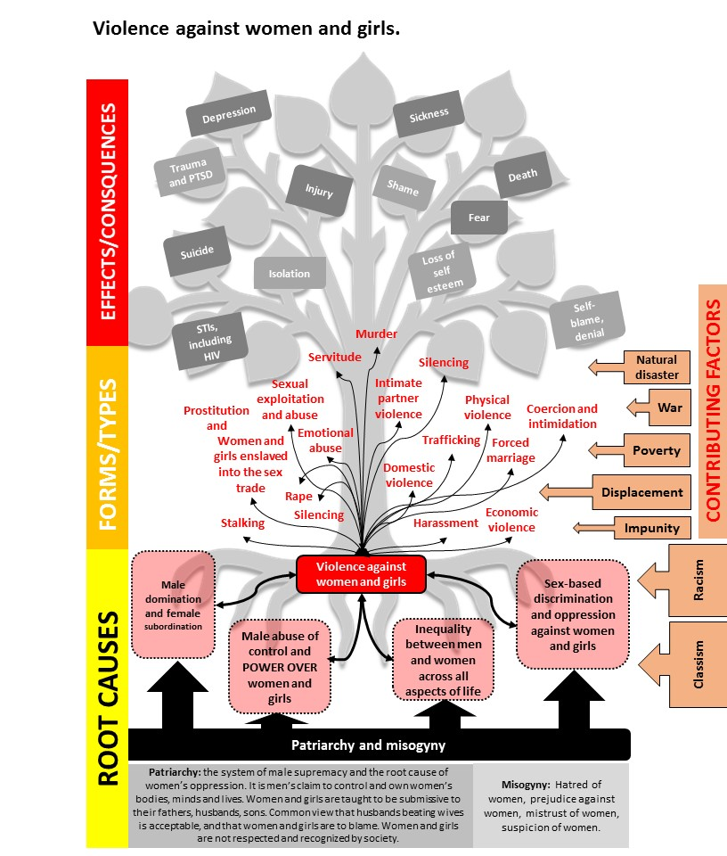
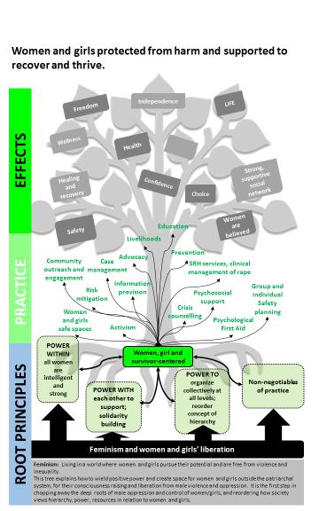

Slide 21
Guiding Principles of VAWG/GBV
  Respect/ right to dignity and self-determination
  Right to confidentiality
Right to safety
  Non-discrimination

Slide 22
Guiding Principles
Right to safety
  Physical and emotional safety
  ALL of our actions prioritize and safeguard the well-being of all women and girls, including survivors
Notes:
The first guiding principle is to establish and ensure safety, both physical and emotional. All case actions that caseworkers take must safeguard the short- and long-term safety of the survivor.

Slide 23
Guiding Principles
Right to confidentiality
  Safe and confidential referrals
  When making a referral, only relevant details are shared, and only with the permission of the woman, girl or survivor
  Information on women and girls who access the Centers must not be shared
  Sharing information happens on a need-to-know basis or in line with center protocols, or laws and policies
  Permission is obtained from women and girls before sharing information
  Photos and videos are not taken in the Centers
Notes:
The second guiding principle of maintaining confidentiality can be achieved by ensuring the confidential collection of information during interviews, that sharing information happens on a need-to-know basis or in line with laws and policies, that permission is obtained from the survivor before sharing information (including information for data collection/monitoring purposes), that when making a referral, only relevant details are shared, and only with the permission of the survivor, and that the case information is stored securely.

Slide 24
Guiding Principles
Respect: Right to dignity and self-determination
  Validating, non-blaming and non-judgmental approach for all women and girls
  Value women and girls, including survivors, and care about their experience, history and future
  Women and girls, including survivors, make their own decisions about support, services and care and this is valued and upheld in the Centers
Notes:
The third guiding principle is the survivor’s right to dignity and self-determination. This can be achieved by taking a validating, non-blaming and non-judgmental approach. Additionally, it can be achieved by valuing the survivor and caring about her experiences, history and future. As caseworkers, we are often the one person in the survivor’s life from whom they can expect to receive unconditional care, support and respect, and it is important to maintain this relationship and trust. Lastly, the self-determination aspect highlights that the survivor is the decision-maker when it comes to the case management process and her care and treatment. Caseworkers have an ethical obligation to value and uphold this.
Note : **This is similar to the guiding principle from the 1995 UNHCR guidelines for working with GBV survivors of “respect the rights and wishes of the survivor.** It was deliberately changed to emphasize the self-determination aspect of a survivor-centred approach.

Slide 25
Guiding Principles
Non-discrimination
  Every adult or child, regardless of her/his sex, should be accorded equal care and support
  All women and girls, including survivors, should receive equal and fair treatment, care and support regardless of their race, religion, nationality or sexual orientation
Notes:
Next, the principle of non-discrimination demands that every adult or child, regardless of her or his sex, should be accorded equal care and support. Additionally, survivors should receive equal and fair treatment regardless of their race, religion, nationality or sexual orientation. However, it must be noted that the priority target population around which GBV case management approaches and services have been built are women and girls—both because they constitute the overwhelming majority of survivors, and because women and girls are subject to specific, widespread and targeted disempowerment and discrimination in their everyday lives, which makes them particularly vulnerable to violence. Services will never be denied to men and boys, but we want to be explicit that our approach, training and skills have been developed with women and girls as the primary intended clients.

Slide 26

Women, Girl and Survivor Centered
Underpinned by feminism and a feminist analysis of the world and anti-oppressive practice
Women’s and girls’ liberation from violence, discrimination and oppression at the heart
Recognizes and confronts the impact on women and girls lives of class, race, sexual orientation, disability, etc.
Focused on women’s and girls’ needs, interests, priorities and lived experiences
Focused on power-within, power-with, and power-to, and solidarity among women
Shaped by an understanding of women’s and girls’ realities
Informed by an understanding of what works for women and girls
Located within women and girl only safe spaces and environments

Slide 27
Feminist Data Collection

Slide 28
Feminist Data Collection
Rooted in social justice
Prioritizes voices of the marginalized or disadvantaged
Participatory & inclusive
Focused on using data for advocacy, NOT donor reporting!
Has a structural analysis of power and inequality underpinning it
Values, centers and promotes women and girls as knowledge creators, their experiential knowledge and their naming of experience
Notes:
Additional resources for feminist research:
- Feminist Research in Theory and Practice, by Gayle Letherby, Open University Press, 2003.
- We All Count weallcount.com/.
- Center for Culturally Responsive Evaluation and Assessment crea.education.illinois.edu/.
- Data Feminism mitpress.mit.edu/books/data-feminism.
- American Evaluation Association Feminist Issues in Evaluation comm.eval.org/feministissuesinevaluation/home
- Feminist Evaluation and Research: Theory and Practice. Edited by Sharon Brisolara, Denise Seigart, and Saumitra SenGupta. New York: The Guilford Press, 2014.
- Feminist Evaluation: Explorations and Experiences. Edited by Sharon Brisolara and Denise Seigart. New Directions for Evaluation, no. 96, 2002.
- Seigart, Denise. “Feminist Evaluation.” By Denise Seigart. Encyclopedia of Evaluation, ed. Sandra Mathison. Thousand Oaks, CA: Sage Publications, 2005.
- “Feminist Evaluation and Gender Approaches: There’s a Difference?” By Donna R. Podems. Journal of MultiDisciplinary Evaluation, 6:14, 2010.
- “Capturing changes in women's lives: the experiences of Oxfam Canada in applying feminist evaluation principles to monitoring and evaluation practice.” By Carol Miller and Laura Haylock. Gender & Development, 22:2, 2014

Slide 29

Feminist Data Collection
What are our shared definitions in this work?
Feminist approaches include having a shared understanding of definitions from the outset!
Notes:
This is meant as a transition point into the next section on Terminology and Language.
Word cloud drawn from contents of the United Nations Basic Principles and Guidelines on the Right to a Remedy and Reparation for Victims of Gross Violations of International Human Rights Law and Serious Violations of International Humanitarian Law (General Assembly resolution 60/147 of 16 December 2005).

Slide 30
Terminology and Language

Slide 31
Review of GBV Words, Terms and Definitions
Ask a group to list all of the GBV words, terms and definitions that may come up during data collection.
Bring in the international definitions of these and discuss them.
Then think about how the team will convey these accurately in the language(s) that will be used during data collection. Make a note of these when you agree on them, so that the whole team has copies for the data collection.

Slide 32
Standard Definitions
GBV
Domestic violence
Intimate partner violence
Sexual violence
Sexual harassment
Sexual exploitation and abuse
[Others that the group raises that may come up during the data collection ]
Notes:
Pull the standard, common definitions from the key GBV minimum standard resources, and use these to start your conversation around agreeing on how to say and talk about these in the languages you will be using for data collection.

Slide 33
Tools Review and Practice

Slide 34
Note-Taking
Review of documents
  Guidance for Note-Takers
  FGD Notes Template
  KII Notes Template

Slide 35
FGD Tools
Review of both tools and discussion/Q&A
Who will use this tool?
Let’s practice!
Notes:
Questions for after practice/role playing:
What worked well about this tool?
What didn’t work as well or was challenging in the FGD?
What language, if any, are you still unclear on or needs more explanation and/or interpretation? How is SH/SEA and GBV being understood and talked about? Will it be clear for our groups?
Do we need to adjust any of the language in the tools to fit our context? If yes, discuss and ensure that the tools are relevant and will be understood by the groups of women and girls you will be engaging.

Slide 36
Staff Perception Survey Tool
Review of both tools and discussion/Q&A
Who will use this tool?
Let’s practice!
Notes:
Questions for after practice/role playing:
What worked well about the tool?
What didn’t work as well or was challenging in the survey?
What language, if any, are you still unclear on or needs more explanation and/or interpretation?

Slide 37
Observational Checklist Tool
Review of both tools and discussion/Q&A
Who will use this tool?
When might you use this tool and discussion on focus areas

Slide 38
KII Tool
Review of both tools and discussion/Q&A
Who will use this tool?
Let’s practice!
Notes:
Questions for after practice/role playing:
What worked well about this tool?
What didn’t work as well or was challenging in the KII?
What language, if any, are you still unclear on or needs more explanation and/or interpretation?
Are there any adjustments we want to make for the tool before we use it?

Slide 39
Note-Taking
Quick revisit to what we learned about note-taking
Do you feel comfortable with what needs to happen?
Q&A
Notes:
Use Guidance for Note-Takers documents to assist you in this conversation.

Slide 40
Barometer Implementation Schedule

Slide 41
Implementation Schedule
[Add details regarding your specific: schedule, including locations, target groups, times, logistics, data collection activities, etc.]
Notes:
Handout your data collection schedule

Slide 42
Ethical and Safety Considerations and Security

Slide 43
Safety and Security
Confidentiality and privacy
Data protection
Informed consent
Security risks, benefits and considerations
Security assessments, procedures and protocols
Safe identification and referrals to services and support when survivors disclose during the Barometer implementation
Notes:
See Section 1. Planning and Preparation and Sub-folder 1.3: Rapid Security Assessment for more information and detail.

Slide 44
Safety and Security
[Add the main points from your security protocol here]
Let’s practice!
Notes:
Discuss your security protocol and develop further with team, ensuring everyone understanding the protocol and the security measures written with in and how they will look in practice/in reality. It is recommended that you rehearse/practice the protocols as much as possible, so the group remembers them.

Slide 45
Team Roles and Responsibilities

Slide 46
Team Roles
Team Leader
Facilitator
Note-Taker/ support
Interpreter
GBV Case Worker/ Manager/ Responder
Notes:
Review these roles with the team, and make sure they collectively understand what each role does and who in their team is fulfilling which role.

Slide 47
Assigning Data Collection Activities
Assign names to the different activities in data collection schedule.
Discuss who will taking each activity.

Slide 48
Group Agreements and
Code of Conduct

Slide 49
Group Agreements
Check and make sure it is clear what each team member is doing and that all are in agreement.
Important areas for discussion for agreement
Q&A
Notes:
Important areas for discussion:
Who is doing what and when?
The need to stay together and with assigned team members at all times
Reporting any issues or concerns as they relate to the data collection and/or security immediately – how and to whom
Equipment and supplies (including first aid kits and water in every car, sat phones where required, etc.)
Daily check-in and debriefs each day when data is being collected
Daily schedules, timing of lunch breaks
Notes and deadlines for completion
Ensure everyone has all the information they need (phone numbers, etc.)
Acknowledge that this work can be difficult and that they may hear very difficult information from participants; ensure the team knows where to go and who to go to if they want to talk anything through in confidence about what they are experiencing and hearing.

Slide 50
Code of Conduct
[Insert the main points of your code of conduct here and review with the team]

Slide 51
Review of GBV Referral Pathways and Contacts

Slide 52
GBV Referrals and Contacts
Current GBV referral pathway(s) and contacts for locations and how work
How to refer survivors
Q&A and concerns

Slide 53
Review of Humanitarian Documents

Slide 54
Humanitarian Documents
GBV Working Group documents
  GBV Standard Operating Procedures or Referral Pathways
  GBVIMS
  Safety audits/ assessments
Prevention of Sexual Exploitation and Abuse (PSEA) Working Group assessments/ reporting protocols
Women’s participation and representation reports/ assessments
Gender and power analysis reports/ assessments
Humanitarian Response Plans
**all as available**

Slide 55
Humanitarian Documents
Is there any relevant information about your site? For example:
  Sectors present or missing?
  Site specific support and/or services?
  Safety audits, GBV or gender analyses/assessments?
  Needs or priorities identified for and/or by women and girls?
  Current status of prevention of SEA/SH by humanitarian community or workplaces?
  Anything else?

Slide 56
Thank You!

