Slide 1
GBV Case Management Outcome Scales
IRC Violence Prevention and Response Unit

Slide 2
Why?
Two Main Objectives of the GBV CM Outcome Monitoring Toolkit
To provide GBV caseworkers with a structured tool for focused individual support with women and older adolescent girls.
To provide GBV response teams with high-quality, aggregated data on psychosocial functioning and stigma across your client caseload to inform programming improvements
Notes:
There are two main objectives of the GBV Case Management Outcome Monitoring Toolkit, one is to help provide GBV caseworkers with a tool to support their work with individual women and older adolescent girls. Measuring progress together can inform better targeted psychosocial support strategies by the caseworkers and action planning by the client. It can also inform referrals for higher level mental health care where needed.
The second objective is to provide GBV response teams with high-quality, aggregated data on psychosocial functioning and stigma across your client caseload to inform programming improvements. To achieve this second objectives, it is critical that the aggregated results collected from the Psychosocial Functionality Scale and Felt Stigma Scale are analyzed and discussed in order to develop actionable recommendations.

Slide 3
What?
The GBV Case Management Outcome Scales measure outcomes, not outputs
The Scales measures the impact of GBV case management on psychosocial functionality and felt stigma.
Notes:
Monitoring and evaluation (M&E) is an important part of accountable and effective GBV response, but traditionally the sector has focused on outputs, for example # of survivors receiving services, # of staff trained and # of dignity kits distributed.
The GBV Case Management Outcome Monitoring Toolkit does M&E by measuring outcomes, not outputs: the impact of gender-based violence (GBV) case management on psychosocial functionality and felt stigma. This toolkit was developed using validated scales measuring changes related to psychosocial wellbeing and stigma experienced by women survivors of GBV in the Democratic Republic of Congo . The IRC has adapted this toolkit for use with women and older adolescent girls receiving GBV case management with the support from Somali and Syrian populations.

Slide 4
The Psychosocial Functionality Scale
A 10-item questionnaire that measures women and older adolescent girls’ ability to carry out important tasks in their daily lives.
Notes:
What does the GBV Case Management Outcome Monitoring Toolkit measure?
The Psychosocial Functionality Scale is a 10-item questionnaire that measures a woman and older adolescent girls’ ability to carry out important tasks in their daily lives.
When you administer the Psychosocial Functionality Scale, you will ask about specific tasks and activities and for the survivor to recall the last four weeks and how difficult it is for them to carry out those activities. For example, How difficult is it to give advice to family members? The response options are:
Not difficult at all (0 points)
Difficult (1 point)
A little bit difficult (2 points)
Very difficult (3 points)
So difficult that you often cannot do it (4 points)

Slide 5
Giving advice to family members
Exchanging ideas with others
Uniting with other community members to do tasks for the community
Asking/getting help from people or organizations when you need it
Making important decisions about daily life
Taking part in family decisions
Learning new skills
Concentrating on your tasks or responsibilities
Interacting or dealing with people you don’t know
Keeping your household clean
The Psychosocial Functionality Scale
Questions
Notes:
The questions on the psychosocial functionality scale ask about:
Give advice to family members
Exchanging ideas with others
Uniting with other community members to do tasks for the community
Asking/getting help from people or organizations when you need it
Making important decisions about daily life
Taking part in family decisions
Learning new skills
Concentrating on your tasks or responsibilities
Interacting or dealing with people you don’t know
Keeping your household clean
At the end of the Scale, you will be able to use the responses to calculate the score.

Slide 6
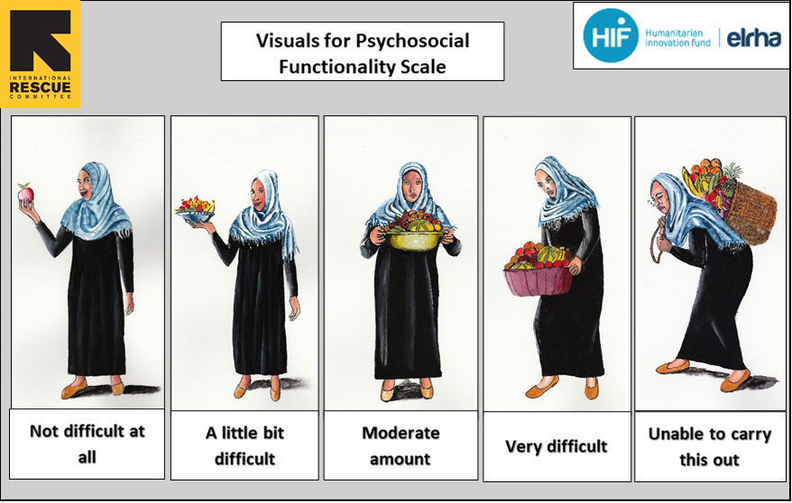
*There are other visuals available if this one does not apply to your context
Notes:
There are other visual guides that accompany the questionnaires if the one shown does not apply for your context. This one has been adapted for Syrian Refugee populations.

Slide 7
The Felt Stigma Scale
A 10-item questionnaire that measures women and older adolescent girls’ both perceived and internalized experiences of stigma.
Notes:
"Felt stigma” is the personal experience of feeling judged or looked down upon by others, impacting self-esteem and behavior. It involves internalizing harmful attitudes, beliefs, and/or discrimination due to a specific experience (like GBV), condition, or circumstance, and is often rooted in patriarchal society and norms. Felt stigma can lead to feelings of shame, guilt, and/or embarrassment, causing individuals to withdraw socially and feel unworthy.
The Felt Stigma Scale is a 10-item questionnaire that measures women and older adolescent girls’ both perceived and internalized experiences of stigma.
To administer the Scale, you will ask the survivor to think about the last four weeks, ask them how much they have had certain thoughts and feelings. For example, “Feelings of worthlessness, of having no value.” The response options are:
Not at all (0 points)
A little bit (1 point)
A moderate amount (2 points)
A lot (3 points)

Slide 8
Feelings of worthlessness, of having no value
Feeling detached or withdrawn from others
Feeling badly treated by community members
Feeling shame
Blaming yourself for past events
Feeling rejected by everybody
Feeling stigma
Wanting to avoid other people or hide
Feeling like your family gazes at you like they are blaming you
Feeling like community members gaze at you like they are blaming you
Felt Stigma
Scale
Questions
Notes:
The felt stigma scale questions cover, with a survivor:
Feelings of worthlessness, of having no value
Feeling detached or withdrawn from others
Feeling badly treated by community members
Feeling shame
Blaming yourself for past events
Feeling rejected by everybody
Feeling stigma
Wanting to avoid other people or hide
Feeling like your family gazes at you like they are blaming you
Feeling like community members gaze at you like they are blaming you
At the end of the Scale, you will be able to use the responses to calculate the score.

Slide 9
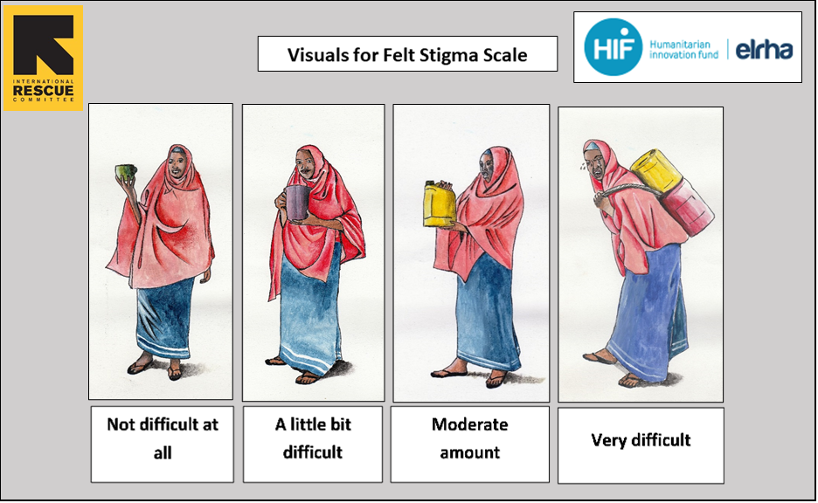
*There are other visuals available if this one does not apply to your context
Notes:
This is another visual guide example to accompany the felt stigma scale questionnaire. Again, there are other visual guides that accompany the questionnaires if the one shown does not apply for your context

Slide 10
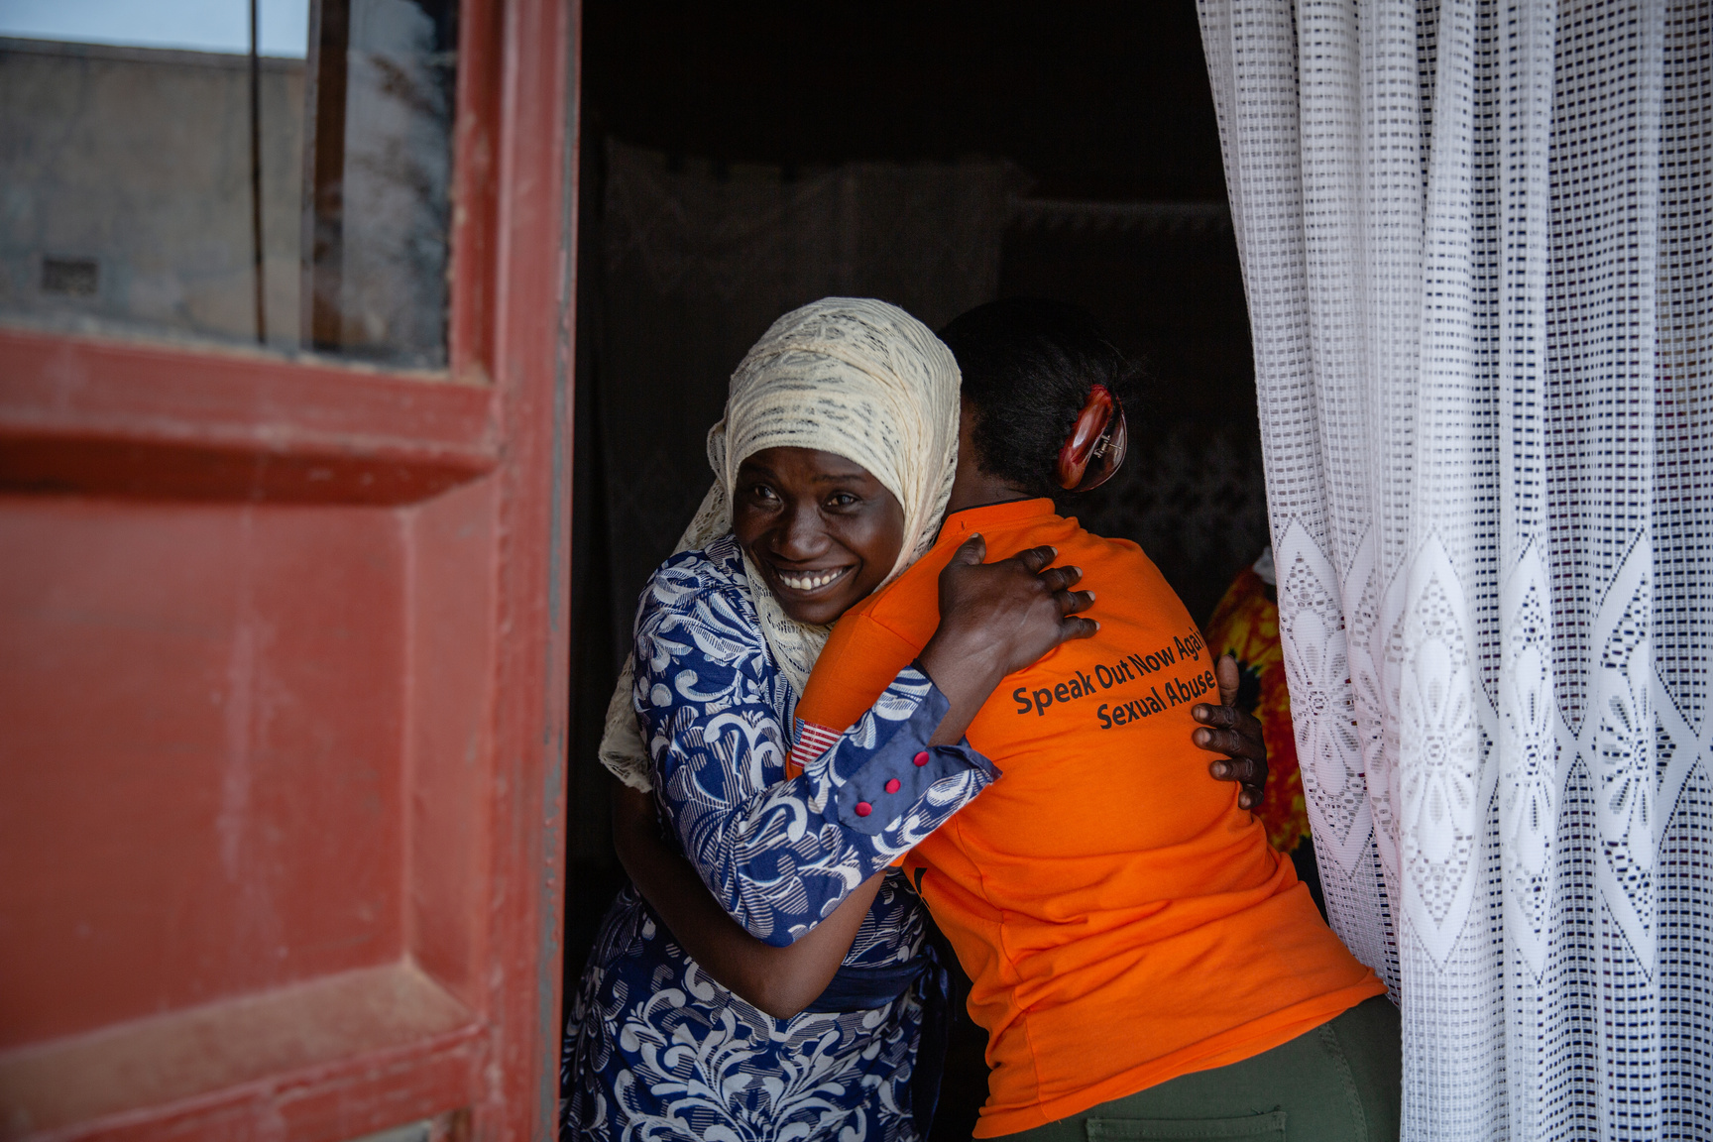
Who?
Female survivors
15 years old and over
Notes:
The toolkit has been tested and validated for use with female survivors, 15 years old and older who are participating in GBV case management services. The toolkit is not suitable for use with girls 14 years old or younger.

Slide 11
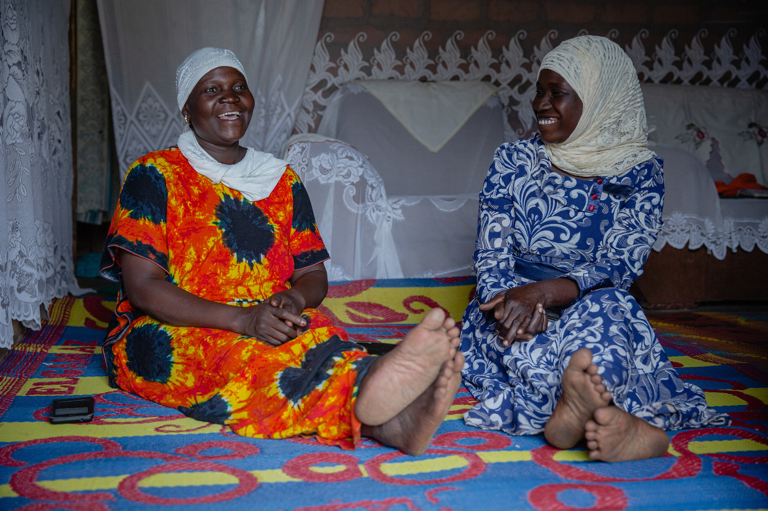
When?
For a one-time measure:
During the assessment of psychosocial needs and support
For measurement over time:
First, at baseline (typically during the assessment of psychosocial needs and support)
Next, after three additional sessions (typically when beginning to discuss case closure)
Again, at the end of the case management intervention plan (if case management exceeds seven sessions)
IRC VPRU
Notes:
When can you use the GBV Case Management Outcome Monitoring Toolkit?
These Scales can be used by GBV case workers as part of the survivor’s psychosocial assessment.
In the Interagency GBV Case Management Guidelines, this corresponds to Step 2 Assessment, Section 3: Psychosocial Needs and Support. It takes approximately 10-20 minutes to administer each of the questionnaires.
For a one-time measure of psychosocial functionality and/or felt stigma:
The tool only needs to be administered once.
It is recommended that the monitoring tool be administered during the assessment of psychosocial needs and support, or after a minimum of three visits, in order for the most urgent needs of the survivors to be addressed and to give time for trust-building.
HOWEVER, administering the Scale after three visits might be challenging in some contexts. If administering the scale for the first time during the fourth session doesn’t align with your context, consider using the one-time measure of psychosocial functionality and/or felt stigma as a part of the assessment of psychosocial needs and support, or Step 2 of the case management process – so long as the survivor is not in acute distress⁴. This provides an opportunity to discuss the Survivor’s wellbeing and may encourage them to return for additional case management sessions.
REMEMBER, it is not recommended to use the Scales during the first session with a survivor.
To monitor change in survivors’ well-being over time:
The Psychosocial Functionality/Felt Stigma scale should be administered at least twice: first, at baseline (typically, during the assessment of psychosocial needs and support) and again after three additional sessions (typically right before case closure or at session 7).
If case management continues or needs to resume based on the second time use of the Scale (instead of moving towards case closure), the Scale can be used a third time when next discussing case closure. When this happens, compare the baseline and the most recent survey.
REMEMBER, this is a recommendation, and you can determine when to use these surveys based on your context.
For example, if you typically only meet with a survivor three times, rather than waiting until the fourth session with a survivor, you could conduct the baseline survey during Step 2 of GBV Case Management: the assessment of psychosocial needs and support, and then every three weeks after that session – or when discussing case closure.
The primary purpose of the scales is to support case management processes, understand the psychosocial needs, and inform action planning with survivors. Determine with your teams when it makes sense to deploy these surveys based on your context.
NOTE: If you are using the Outcome Monitoring Toolkit for calculating and reporting indicators, ensure that your program’s use of the Scales aligns with your measurement requirements. Reach out to your Technical Advisor and M&E Focal Point if you have additional questions or concerns.

Slide 12

Video
04
Placeholder for how to administer video
IRC VPRU
Notes:
Video: How to Administer the GBV Case Management Outcome Scales
https://youtu.be/67glIZLDGVU

Slide 13
01
Introduce the Scale(s) to the survivor
02
Lead the survivor through the questionnaire
How?
IRC VPRU
Notes:
Now that you know what the GBV Case Management Outcome Monitoring Toolkit is, how do you use it?
Step 1: Introduce the tool to the survivor and receive consent to use them
Explain: “In today’s session, I’d like to ask if you’d be interested in completing an activity together which will help us to understand how you are feeling currently in recovering from the violence you have experienced. These questions help us assess your feelings, your daily life activities and your relationships. Together, we can use your responses to help develop an action plan. Would you like to complete this activity together?”
If the survivor agrees, proceed to step 2.
Step 2: Lead the survivor through the questionnaire, using contextualized visual aids when relevant.
Explain: “Now I will ask you some questions about the feelings, activities and relationships which you have chosen as important to your recovery. Here is a picture which shows a woman holding a burden (basket, water can, etc.) who is finding a task not difficult, a little difficult, difficult, very difficult or so on. When you think about whether an activity or feeling is difficult or not, you can refer to this picture as a guide.”
Do: Read out the questions from the Psychosocial Functionality Scale and/or Felt Stigma Scale (depending on what you wish to monitor) (see questionnaires below).
Do: Make sure that you are using the correct visual guidance / pictures. There are two versions: one for the psychosocial functioning scale, and one for the felt stigma scale.
Remind Survivors: “If you feel uncomfortable or wish to stop this activity at any time, please let me know.”

Slide 14
03
Support the survivor to select relevant feelings, activities and relationships
04
Return to the action planning activity or case closure process within your case management session
How?
IRC VPRU
Notes:
Step 3: Support the survivor to select relevant feelings, activities, and relationships to focus on during the development or refining of their case action plan.
Explain: “Thank you for answering all of these questions. You shared with me aspects of your life, including some which are currently difficult. Of all those items that we just discussed, which three tasks & activities or thoughts & feelings that you would most like to prioritize as we develop your action plan? If you’d like, we can look through the questions that I just asked you, as a reference. You do not need to select those that you rated as most difficult, but rather the ones that are most important to you in terms of developing an action plan.”
Do: Share the list of feelings and activities below with the survivor either on paper or verbally if the survivor has lower literacy levels. Pause after each section and ask her to select the examples most relevant to her action planning to support her recovery.
Do: Review the items from the Psychosocial Functionality Scale and/or the Felt Stigma Scale with the survivor, as relevant.
Step 4: Incorporate the answers as needed to plan. Return to the action planning activity within your case management session.
Now that you have supported the survivor to document how she is currently feeling and functioning, move to the action planning process and support the survivor to identify her goals for the coming week(s) before you meet again. In cases where this is a part of discussing case closure, return to the case closure process with your case management sessions.

Slide 15
01
Use the Psychosocial Functionality and/or Felt Stigma Scale to support the survivor’s action planning.
02
Familiarize yourself with the Scale(s) your team is using in your context.
Tips
Notes:
Beyond measuring outcomes, the GBV Case Management Outcome Scales are meant to be used to support and refine action planning with the survivor. Together, reflect on and select relevant feelings, activities, and relationships from the Scales to develop and refine their action plan.
Familiarizing yourself with the Scales will make them feel more organic when you administer them with the survivor. The Scales should feel more like a conversation than an additional form.

Slide 16
03
Weave the Scale questions into your case management sessions with survivors when appropriate.
04
If the survivor doesn’t understand the question, you can help explain it in your own words. You can also use the visuals as needed.
Tips
Notes:
3. Once you are comfortable with the tool, you can seamlessly incorporate the Scales into your case management action planning sessions with survivors, rather than treating them like an additional form. Introduce the tool and receive informed consent, then weave the questions into the assessment. These surveys are meant to support and guide your case management decisions with survivors, and they are therefore flexible.
For example, instead of saying “How difficult is it for you to unite with other community members to do tasks for the community? Select one of the following options...”, you could weave something into the conversation such as: “How have you been involved in your community in the past? How have you felt about being with and involving yourself with your community now?”
Or, instead of saying “How difficult is it for you to keep your household clean? Select one of the following options...”, you could weave something into the conversation like: “I know it takes a lot of work to maintain a house – how have you felt about doing those same things now?”
Based on the response of the survivor, you can select the most appropriate survey response.
It is okay if you don’t ask all the questions – you can calculate the score based on how many questions were answered!

Slide 17

Do I need to use both?
No.
Notes:
When implementing the Scales as a part of GBV Case Management services, country program teams along with their supporting Technical Advisor should determine which Scale, or if both Scales, should be used during case management.
Then, with each client, you can choose to administer only one of the scales, or you can administer both of the scales (either during the same case management session or split across two sessions), depending on what aspects you and the client agree together to monitor or what your program overall decides to monitor.

Slide 18
Video
Placeholder for how to analyze video
Notes:
Play video (by Woven Ink)

Slide 19
Psychosocial Functionality Scale: Calculate
01
5-point Scale
Not difficult at all (0 point)
A little bit difficult (1 point)
Difficult (2 points)
Very difficult (3 points)
So difficult that you often cannot do it (4 points)
02
Add the points across all 10 items
03
Divide the total by 10
If the survivor skipped one or more item in the questionnaire, add the points for all answered questions, and divide by the total number of questions answered.
For example, if the survivor answered 8 questions, divide the sum by 8.
IRC VPRU
Notes:
FACILITATOR NOTE: Share a prepared filled scale – for people to calculate along with the facilitator. For example:
Give advice to family members - 2
Exchanging ideas with others - 3
Uniting with other community members to do tasks for the community - 3
Asking/getting help from people or organizations when you need it - 2
Making important decisions about daily life - 2
Taking part in family decisions - 2
Learning new skills - 4
Concentrating on your tasks or responsibilities - 4
Interacting or dealing with people you don’t know - 3
Keeping your household clean - 3
The score: 28 / 10 = 2.8
***************************************
For the psychosocial functionality scale, all the items in the questionnaire are based on a 5-point scale, with the values as listed.
To calculate the results for an INDIVIDUAL woman or older adolescent girl, first add the points across all 10 items. Then, divide the total number by 10.
If the survivor skipped one or more item in the questionnaire, add the points for all answered questions, and divide by the total number of questions answered. For example, if the survivor answered 8 questions, divide the sum by 8.

Slide 20
Psychosocial Functionality Scale: Calculate
Give advice to family members | 2
Exchanging ideas with others | 3
Uniting with other community members to do tasks for the community | 3
Asking/getting help from people or organizations when you need it | 2
Making important decisions about daily life | 2
Taking part in family decisions | 2
Learning new skills | 4
Concentrating on your tasks or responsibilities | 4
Interacting or dealing with people you don’t know | 3
Keeping your household clean | 3
BASELINE SCORE | ???
IRC VPRU
Notes:
FACILITATOR NOTE: Have someone calculate the score for this Scale based on the responses/numbers in the slide/shared survey
Answer = 28 / 10 = 2.8

Slide 21
Psychosocial Functionality Scale: Interpret
0 - 1
Survivor is experiencing little to no difficulty in accomplishing tasks
1 - 1.5
Survivor is experiencing minimal and sometimes moderate amount of difficulty in accomplishing tasks.
  Check whether the survivor indicated that specific items in the questionnaire were more difficult to carry out and ask the survivor if these ‘more difficult’ items should be the focus of her action plan.
IRC VPRU
Notes:
Once you have calculated the score for an individual woman or older adolescent girl, you can refer to and interpret the results and use them to create a (non-emergency) action plan with the survivor.
If the score is 0 to 1, this suggests that the survivor is experiencing little to no difficulty in accomplishing tasks.
If the score is 1 - 1.5, this suggests that the Survivor is experiencing minimal and sometimes moderate amount of difficulty in accomplishing tasks.
Check whether the survivor indicated that specific items in the questionnaire were more difficult to carry out (for example, she indicated that one item is ‘very difficult’) and ask the survivor if these ‘more difficult’ items should be the focus of her action plan.

Slide 22
Psychosocial Functionality Scale: Interpret
1.5 - 2.25
Survivor is experiencing moderate to significant difficulties in at least some accomplishing tasks.
  Work with the survivor to help identify which tasks to prioritize for the survivor’s action plan.
2.25 - 4
Survivor is experiencing significant difficulties in accomplishing tasks and may often not be able to carry these tasks out at all.
  Work with the survivor to help identify which tasks to prioritize for the survivor’s action plan.
  It may be advisable for the caseworkers to discuss cases with very high scores with their supervisors.
IRC VPRU
Notes:
If the score is 1.5 - 2.25, this suggests that the survivor is experiencing moderate to significant difficulties in accomplishing at least some tasks.
It will be important to work with the survivor to help identify which tasks to prioritize for the survivor’s action plan. Note that the items or tasks do not necessarily need to be those that the survivor scored as most difficult, but can also be the tasks that are most relevant to the survivor’s daily life.
If the score is 2.25 - 4, this suggests that the survivor is experiencing significant difficulties in accomplishing tasks, and may often not be able to carry these tasks out at all.
Based on the score in our example, the survivor falls into this category, and they are experiencing significant difficulties in accomplishing tasks.
Again, it will be important to use a survivor-centered approach with the survivor to help identify which tasks to prioritize for the survivor’s action plan. The items do not necessarily need to be those that the survivor scored as most difficult but can also be the tasks that are most relevant to the survivor’s daily life.
Based on the Scale example from the previous slide, we know that the survivor responded with “very difficult (4)” for a few questions. What could this indicate? Along with the score, what might you do with that information?
Learning new skills – 4
Concentrating on your tasks or responsibilities - 4
It may also be advisable for the caseworker to discuss cases with very high scores, like this example, with their supervisors to get additional advice on how to support these survivors as they may have specialized needs.
Consider linking the survivor with specialized MHPSS services and be sure to follow up with the survivor.
Follow up with the survivor with additional case management sessions and revisit the Scale then to check her progress.

Slide 23
Psychosocial Functionality Scale: Change Over Time
most recent Scale score - baseline Scale/previous Scale score = change over time score
Level of change | Difference between scores (2nd score MINUS 1st score)
Small | 0 to +0.17
 | 0 to -0.17
Medium | +0.18 to +0.66
 | - 0.18 to -0.66
Large | 0.67 and up
 | -0.67 and lower
IRC VPRU
Notes:
If you would like to measure improvements in survivors’ well-being over the course of case management, and you have at least two scores for a survivor over time (for example, from the assessment of psychosocial needs and support and again when discussing case closure) you can compare the average for each questionnaire by calculating the difference between the scores.
Depending on the most recent Scale score, you may have a positive or negative result for the change over time score. If the score is negative, this indicates a decrease in difficulties around performing tasks, which suggests an improvement in a survivor’s psychosocial functionality. If the score is positive, this indicates an increase in difficulties around performing tasks, which may suggest a decrease in a survivor’s psychosocial functionality.
To interpret the change over time score, you need to consider it along with the original score. Knowing if there was a small, medium, or large change does not give us enough information – we need to also know the direction of the change.
For example, a survivor may have a baseline Scale score that shows they started off the case management process experiencing little to no difficulty in accomplishing tasks. Their most recent survey score, in comparison, may have changed to indicate that they are experiencing significant difficulties in accomplishing tasks. The change over time score would then show a large, positive change meaning that since the initial Scale was administered the survivor has experienced a significant increase in difficulties when performing tasks. Despite GBV case management and the survivor initially feeling little to no difficulty when accomplishing tasks, the survivor has experienced deteriorating psychosocial functioning.
Use this information to inform your decision making with the survivor. Discuss the action plan along with specialized referrals with the survivor. You can also each out to your supervisor in order to get additional support on the case.
You can refer to the GBV Case Management Outcome Scale Practitioner Guidance document for more detailed guidance on interpretation and data-driven actions.

Slide 24
Psychosocial Functionality Scale: Change Over Time Example
Give advice to family members | 2
Exchanging ideas with others | 3
Uniting with other community members to do tasks for the community | 3
Asking/getting help from people or organizations when you need it | 2
Making important decisions about daily life | 2
Taking part in family decisions | 2
Learning new skills | 4
Concentrating on your tasks or responsibilities | 4
Interacting or dealing with people you don’t know | 3
Keeping your household clean | 3
BASELINE SCORE | 2.8
Give advice to family members | 0
Exchanging ideas with others | 1
Uniting with other community members to do tasks for the community | 1
Asking/getting help from people or organizations when you need it | 1
Making important decisions about daily life | 1
Taking part in family decisions | 0
Learning new skills | 2
Concentrating on your tasks or responsibilities | 2
Interacting or dealing with people you don’t know | 1
Keeping your household clean | 1
MOST RECENT SCORE | 1
Most Recent Score – Baseline Score = Change Over Time Score
Notes:
****************************EXAMPLE************************************************
FACILITATOR NOTE: HAVE PARTICPANTS CALCULATE THE SCORE AND SHARE THE ANSWER. Ask for their feedback from the questions in the notes below.
In this example, the baseline Psychosocial Functionality score is 2.8. In the endline, or most recent Scale, the score is 1.
1 – 2.8 = -1.8
This is a large, negative change over time score, suggesting that the survivor is experiencing a significant decrease in difficulties when accomplishing tasks.
**************************************************************************************
Based on these Scale scores:
What is the change over time score?
-1.8
Does this indicate a small, medium, or large change?
This is a large change
Is it positive or negative change?
Negative
In the context of the survivor’s original score, what does this mean?
The survivor was experiencing significant difficulties in accomplishing tasks during the initial assessment of psychosocial needs and support, and they may often not be able to carry daily tasks out at all.
Since then, there has been a large, or significant decrease in difficulties when performing tasks.
This suggests that the survivor’s psychosocial functioning has significantly improved with the support of GBV case management. However, since they started at a significant level of difficulty performing tasks, this means they may still need additional support.
What actions could you or a caseworker take to support the survivor with this information?
This could be an opportunity to further empower the survivor to deal with long-term trauma, such as planning how to implement and prioritize self-care. Revisit the safety plan and help survivor understand the importance of staying safe and healthy.
You can use this as an opportunity to work with the survivor to revisit the action plan and re-prioritize tasks to focus on.
Check whether the survivor indicated that specific items in the questionnaire were more difficult to carry out (for example, she indicated that one item is ‘very difficult’) and ask the survivor if these ‘more difficult’ items should be the focus of her action plan. Ask the survivor what ideas she has to make the tasks less difficult and what small steps she can focus on to help support her improved wellbeing.
This change-over-time result may indicate that the survivor may be ready to end the case management process. Ask the survivor how she feels about closing the sessions, if there are other plans she has for her future, and if she would like support in developing a new action plan that she could use to follow her plans accordingly and outside of case management.
You can also discuss with your case management supervisor to determine the next steps for case closure.

Slide 25
Felt Stigma Scale:
Calculate
01.
4-point Scale
Not at all (0 point)
A little bit (1 point)
A moderate amount (2 points)
A lot (3 points)
02.
Add the points across all 10 items
03.
Divide the total by 10
If the survivor skipped one or more item in the questionnaire, add the points for all answered questions, and divide by the total number of questions answered.
For example, if the survivor answered 8 questions, divide the sum by 8.
Notes:
FACILITATOR NOTE: Share a prepared filled scale – for people to calculate along with the facilitator
Feelings of worthlessness, of having no value - 1
Feeling detached or withdrawn from others - 3
Feeling badly treated by community members - 1
Feeling shame - 2
Blaming yourself for past events – 0
Feeling rejected by everybody – 1
Feeling stigma - 1
Wanting to avoid other people or hide - 3
Feeling like your family gazes at you like they are blaming you – 0
Feeling like community members gaze at you like they are blaming you - 1
The score: 13 / 10 = 1.3
***************************************
For the Felt Stigma Scale, all of the items in the questionnaire are based on a based on a 4-point scale, with the values:
Not at all (0 point)
A little bit (1 point)
A moderate amount (2 points)
A lot (3 points)
To calculate the results for an INDIVIDUAL woman or older adolescent girl, first add the points across all 10 items. Then, divide the total number by 10.
If the survivor skipped one or more item in the questionnaire, add the points for all answered questions, and divide by the total number of questions answered. For example, if the survivor answered 8 questions, divide the sum by 8.

Slide 26
Felt Stigma Scale:
Calculate Example
Feelings of worthlessness, of having no value | 1
Feeling detached or withdrawn from others | 3
Feeling badly treated by community members | 1
Feeling shame | 2
Blaming yourself for past events | 0
Feeling rejected by everybody | 1
Feeling stigma | 1
Wanting to avoid other people or hide | 3
Feeling like your family gazes at you like they are blaming you | 0
Feeling like community members gaze at you like they are blaming you | 1
BASELINE SCORE | ???
Notes:
FACILITATOR NOTE: Have someone calculate the score for this Scale based on the responses/numbers in the slide/shared survey
Answer = 13 / 10 = 1.3

Slide 27
Felt Stigma Scale:
Interpret
0 - 1
Survivor is experiencing little to no felt stigma
1 - 2
Survivor is experiencing minimal to moderate amount of felt stigma.
  Check whether the survivor indicated that specific items in the questionnaire were more difficult and ask the survivor if these ‘more difficult’ items should be the focus of her action plan.
2 - 3
Survivor is experiencing moderate to significant amount of felt stigma.
  The survivor is likely having difficulties related to a number of feelings related to felt stigma. It will be important to work with the survivor to help identify which feelings to prioritize for the survivor’s action plan.
Notes:
Once you have calculated the score for an individual woman or older adolescent girl, you can refer to and interpret the results and use them to create a (non-emergency) action plan with the survivor. No matter the score, be sure to ask the survivor questions that reflect a survivor-centered approach.
If the score is 0 to 1, this suggests that the survivor is experiencing little to no felt stigma.
Here you can acknowledge the survivor’s progress and consider activities with them to further enhance their sense of empowerment.
If the score is 1 - 2, the Survivor is experiencing minimal to moderate amounts of felt stigma.
Based on the score in our example, the survivor falls into this category, and they are experiencing significant difficulties in accomplishing tasks.
Check whether the survivor indicated specific feelings in the questionnaire that they experience more frequently compared to others (in this example, she indicated that she has ‘a lot’ of feelings of being detached or withdrawn from others as well as Wanting to avoid other people or hide) and ask the survivor if these more frequent thoughts and feelings should be the focus of her action plan.
Follow up with the survivor with additional case management sessions and revisit the Felt Stigma Scale then to check her progress.
If the score is 2-3, the Survivor is experiencing moderate to significant amounts of felt stigma.
The survivor is likely having difficulties related to a number of feelings related to felt stigma. It will be important to work with the survivor to help identify which feelings to prioritize for the survivor’s action plan. Note that the items do not necessarily need to be those that the survivor scored as most difficult, but can also be the feelings and experiences that are most relevant to the survivor’s daily life.
It may be advisable for the case manager to discuss cases with very high scores with their supervisors, in order to get additional advice on how to support these survivors as they may have specialized needs.
Consider linking the survivor with specialized MHPSS services.

Slide 28
Felt Stigma Scale:
Change Over Time
most recent Scale score - baseline Scale/previous Scale score = change over time score
Level of change | Difference between scores (2nd score MINUS 1st score)
Small | 0 to +0.2
 | 0 to -0.2
Medium | +0.2 to +1.2
 | - 0.2 to -1.2
Large | 1.2 and up
 | -1.2 and lower
Notes:
If you would like to measure improvements in survivors’ sense of experienced and internalized felt stigma during the course of case management, and you have at least two scores for a survivor over time (for example during the assessment of psychosocial needs and support and again when discussing case closure), you can compare the average for each questionnaire and calculate the difference between the average scores.
Similar to the Psychosocial Functionality Change Over Time Score, you may have a positive or negative result for the change over time score. If the score is negative, this indicates a decrease in feelings of felt stigma, which suggests an improvement in a survivor’s outcomes as a result of case management. If the score is positive, this indicates an increase in felt stigma, which may suggest a decrease in a survivor’s wellbeing.
To interpret the change over time score, you need to consider it along with the original score. Knowing if there was a small, medium, or large change does not give us enough information.
You can refer to the GBV Case Management Outcome Scale Practitioner Guidance document for more detailed guidance on interpretation and data-driven actions based on the change over time score.

Slide 29
Felt Stigma Scale:
Change Over Time
Feelings of worthlessness, of having no value | 1
Feeling detached or withdrawn from others | 3
Feeling badly treated by community members | 1
Feeling shame | 2
Blaming yourself for past events | 0
Feeling rejected by everybody | 1
Feeling stigma | 1
Wanting to avoid other people or hide | 3
Feeling like your family gazes at you like they are blaming you | 0
Feeling like community members gaze at you like they are blaming you | 1
BASELINE SCORE | 1.3
Feelings of worthlessness, of having no value | 1
Feeling detached or withdrawn from others | 2
Feeling badly treated by community members | 1
Feeling shame | 2
Blaming yourself for past events | 0
Feeling rejected by everybody | 1
Feeling stigma | 1
Wanting to avoid other people or hide | 2
Feeling like your family gazes at you like they are blaming you | 0
Feeling like community members gaze at you like they are blaming you | 1
MOST RECENT SCORE | 1.1
Most Recent Score – Baseline Score = Change Over Time Score
Notes:
****************************EXAMPLE************************************************
FACILITATOR NOTE: HAVE PARTICPANTS CALCULATE THE SCORE AND SHARE THE ANSWER. Ask for their feedback from the questions in the notes below.
In this example, the baseline Felt Stigma score is 1.3. In the endline, or most recent Scale, the score is 1.1.
1.1 – 1.3 = -0.2
This is a small, negative change over time score, suggesting that there has been little change or a small decrease in a survivor’s experience of felt stigma.
**************************************************************************************
Based on these Scale scores:
What is the change over time score?
-0.2
Does this indicate a small, medium, or large change?
This is a small change
Is it positive or negative?
Negative
In the context of the survivor’s original score, what does this mean?
The survivor was feeling minimal to moderate amounts of felt stigma during their assessment.
Since then, there has been little change or a small decrease in a survivor’s experience of felt stigma
This suggests that the survivor has continued to experience minimal and occasionally moderate amounts of perceived and internalized felt stigma since the first administration of the Scale. .
What actions could you or a caseworker take to support the survivor with this information?
This could be an opportunity to further empower the survivor to deal with long-term trauma, such as planning how to implement and prioritize self-care. Revisit safety plan and help survivor understand the importance of staying safe and healthy.
You can use this as an opportunity to work with the survivor to revisit the action plan and re-prioritize tasks to focus on
Check whether the survivor indicated that specific thoughts or feelings in the questionnaire were experienced more frequently (for example, she may have indicated that one feeling is occurring ‘a lot’) and ask the survivor if these more frequent thoughts and feelings should be the focus of her action plan.
Because there is little change, though there is a slight improvement, the change-over-time result may indicate that it is advisable for the case manager to discuss the case with their supervisors, in order to get additional advice on how to support these Survivors as they may have specialized needs, such as specialized MHPSS.

Slide 30
Programmatic Decision Making Using the
Psychosocial Functionality Scale and Felt Stigma Scale
Data analysis and interpretation using
one-time survey results
Notes:
Case Management Supervisors, Program Managers, Coordinators, and Technical Advisors can gain insight into their programming and make data-driven decisions when they analyze and interpret the GBV Case Management Scales across their program. To do this, you need an overview of the Psychosocial Functionality and/or Felt Stigma scores across your program.
We will go through these steps with some concrete examples, but in order to use individual Scale scores for programmatic decision-making:
First, Collect the scores from the Psychosocial Functionality Scale and/or Felt Stigma Scale across your program.
Then, group the scores into distribution categories and count the number of scores that fall into each category.
Next, visualize the distribution using a bar graph.
Finally, analyze and interpret the bar graph to inform your programming. You can refer to the GBV CM Outcome Scale Practitioner Guidance for interpretation tables to support this step.

Slide 31
GBV CM Outcome Scales:
Distribution of scores from a single administration of the scale
0 to 1 | Survivors experiencing little to no difficulty in accomplishing tasks.
1 to 1.5 | Survivors experiencing minimal and sometimes moderate amount of difficulty in accomplishing tasks.
1.5 to 2.25 | Survivors experiencing moderate to significant difficulties in accomplishing at least some tasks.
2.25 to 4 | Survivors experiencing significant difficulties in accomplishing tasks and may often not be able to carry these tasks out at all.
Average Psychosocial Functionality Baseline score across
46 survivors: 2.33.
Notes:
To use scores from a single administration of the Scales, use scores from either the baseline Scale administration or the endline Scale administration. Do not combine these.
We then recommend creating a bar graph indicating the number of survivors in each score category. For the Psychosocial Functionality Scale this is 0 to 1; 1 to 1.5; 1.5 to 2.25; and 2.25 to 4. For the Felt Stigma Scale, these categories are: 0-1, 1-2, 2-3. You can also include the average across all survivors.
Why not just use the average? It may hide a lot of variation across your caseload that requires specific attention. For example, you may have a number of women or older adolescent girls with very high scores that require additional support, such as specialized therapies.
By grouping the scores and visualizing the distribution, you are able to look for patterns in the data that may indicate specific programmatic needs. In this example, we have color coded the categories from green to red to indicate no or little difficulty to significant difficulty accomplishing tasks. We can see that there is a large number of scores between 1.5-2.25. This suggests that most survivors are experiencing moderate to significant amounts of difficulties in accomplishing at least some tasks. Knowing this, there are actions that you can consider to improve your programming.
For example, once you’ve identified this trend, you could:
Enhance Survivor Feedback:
Collect survivors’ feedback on their experiences and refine support strategies accordingly.
Enhance Training and Support for Staff:
Provide comprehensive training for caseworkers on GBV Case Management, Minimum Standards, and the GBV Case Management Outcome Toolkit. This will enhance their capacities and skills in monitoring and responding to survivors’ needs and ability to accomplish tasks.
Increase support services for GBV case management staff to reduce burnout and address heavy caseloads, including psychosocial support.
Additional trainings and support may also be considered, including sensitivity and survivor-centered approaches or psychosocial support for caseworkers.
Enhance GBV Case Management Services:
Increase case management support services for survivors to manage and increase their ability to accomplish tasks.
These are recommended actions you can take knowing the trends in your context, but this list is not exhaustive. Triangulate the data, and use your contextual knowledge to determine how to move forward now that you’ve interpreted the results.

Slide 32
Programmatic Decision Making Using the
Psychosocial Functionality Scale and Felt Stigma Scale
Data analysis and interpretation using
change-over time survey results
Notes:
To use the change-over time scores to inform programming, you will follow the same steps as you would when using the single administration scores. The main difference is that you are using the change-over time scores (indicated by small, medium, and large changes) rather than just the baseline or just the endline scores.

Slide 33
GBV CM Outcome Scales:
Distribution of change in score from
baseline to follow up
Large, Negative Change | Suggests very strong and successful programming.
Medium, Negative Change | Suggests strong programming.
Small Change | Requires additional information to determine programmatic needs. Further follow up needed.
Medium, Positive Change | STRONG CONCERN: Suggests a need to revisit programmatic structures and to support case management teams. Further follow up needed
Large, Positive Change | CRITICAL CONCERN: Suggests a need to revisit programmatic structures and to support case management teams. Further follow up needed.
Average Level of Change Over Time Score for Felt Stigma
across 35 clients: -0.51
Notes:
To begin analysis and interpretation of the change-over time scores across your programming:
You will collect the change over time scores from the Psychosocial Functionality and/or Felt Stigma Scales from across your program.
Then, group the change over time scores into distribution categories and count the number of scores that fall into each category.
For psychosocial functionality scale score grouping, you will use: 0.67 and below, -0.18 to -0.66, 0 to -0.17, 0 to 0.17, 0.18 to 0.66, 0.67 and above.
For felt stigma scale score grouping, you will use : 0 to -0.2, 0 to+0.2, -0.2 to -1.2, +0.2 to +1.2, -1.2 and lower, +1.2 and higher
Next, visualize the distribution using a bar graph.
Finally, analyze and interpret the bar graph to inform your programming. You can refer to the GBV CM Outcome Scale Practitioner Guidance for interpretation tables to support this step.
The bar graph (Figure 3) above indicates the number of change over time Felt Stigma scores according to the identified distribution categories. In this example, we have color coded the categories from green to red to indicate strong programming to programming that may have critical concerns and needs. By grouping the scores and visualizing the distribution, you can easily look for patterns in the data that may indicate specific programmatic needs.
In this example, one thing we can see is that there is a large number of change-over-time Felt Stigma scores between -0.2 and -1.2. This suggests that most survivors are experiencing a moderate decrease in experiences of felt stigma which indicates strong programming. Knowing this, there are actions that you can consider. For example:
Monitor and Analyze Further:
Continue to gather data to identify factors contributing to this decrease, to reinforce these trends. Engage with caseworkers to understand perceptions and experiences better.
Strengthen Successful Interventions:
Identify interventions that are currently working to support survivors and scale them up, including GBV Case Management.
Community Engagement:
Invest in opportunities to address root causes of stigma and empower women and girls to continue driving this positive change.
These are recommended actions you can take knowing the trends in your context, but this list is not exhaustive. Triangulate the data, and use your contextual knowledge to determine how to move forward now that you’ve interpreted the results.

Slide 34
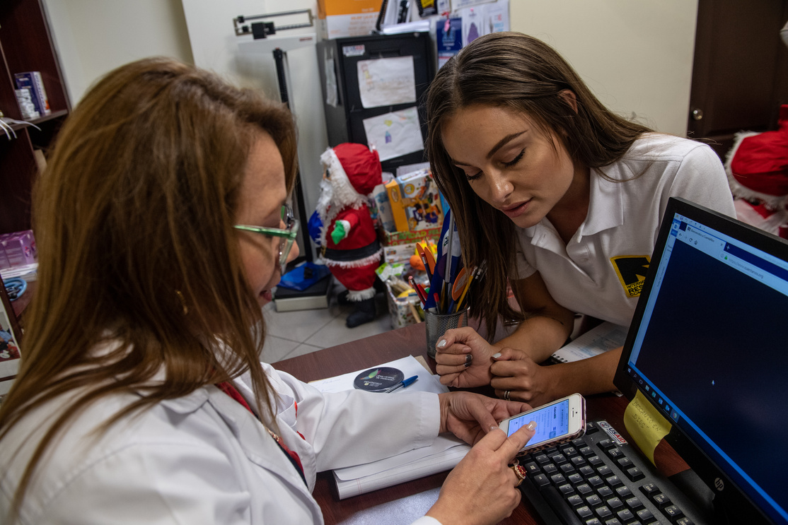
Use the results.
Notes:
When we collect data, it’s important that we USE it. These GBV Case Management Outcome Scales provide an opportunity to understand how case management services impact survivors, AND, more broadly, how our programming is working and what changes may be needed.
With the objectives of the toolkit in mind, the de-identified results from the Outcome Monitoring Scales can be used to report on case management outcomes to stakeholders (including women and girls themselves); To measure change in the woman or older adolescent girls well-being over time, during the course of case management (*requires each survivor answered the questionnaire at least twice, for example during the assessment and again when discussing case closure); and to inform improvements in GBV case management approaches in order to better address needs of women and girl survivors of GBV.
For example, if a survivor’s feelings of stigma were initially high and are continuing to become worse, this would signal to the caseworker that they should discuss the case with their supervisors, in order to get additional advice on how to support the survivor, as they may have specialized needs, such as specialized MHPSS. OR, if many survivors psychosocial functionality are worsening over time and they experiencing significant increases in difficulties accomplishing tasks, this would indicate an urgent need to revisit programmatic structures and support case management teams. The program could monitor and analyze further with team meetings to identify what is happening, provide additional support to case management staff, and/or adjust the case management program to implement or identify services to increase survivors’ social networks.
Remember, de-identified data should not include: first names of subjects, last names of subjects, dates of birth, addresses or GPS locations, identifying photos, phone numbers, unique ID numbers (such as national IDs), etc.

Slide 35
Use the results.
Notes:
FACILITATOR NOTE: Watch the How to Use the Case Management Outcome Scales video
https://youtu.be/SM3y8uFIzQA
***************************************
With the objectives of the toolkit in mind, the de-identified results from the Outcome Monitoring Toolkit can be used to report on case management outcomes to stakeholders (including women and girls themselves); To measure change in the woman or older adolescent girls well-being over time, during the course of case management (*requires each survivor answered the questionnaire at least twice, for example at session 4 and again at session 7); and to inform improvements in GBV case management approaches, to better address needs of women and girl survivors of GBV.
De-identified data should not include: first names of subjects, last names of subjects, dates of birth, dates of birth, addresses or GPS locations, identifying photos, phone numbers, unique ID numbers (such as national IDs).

Slide 36
Contextualization & Adaptation
For new contexts and populations
Notes:
FACILITATOR NOTE: Determine in advance if you need the following slides on contextualization and adaptation
***************************************
The GBV Case Management Outcome Monitoring Toolkit was tested and validated for two different populations of women and older adolescent girls: Syrian refugees and Somali refugees, and the initial version of the scales were developed for the eastern region of Democratic Republic of Congo. The 10-item Psychosocial Functionality Scale and the 10-item Felt Stigma Scale are effective and culturally-appropriate measures in these and similar settings. For any other populations, we also recommend that you use the two scales without modifications or deletions.
However, you can choose to add additional questions that are addressing specific aspects of your programming context, especially if there are certain daily activities, experiences of relationships, or expressions of feelings that are prevalent to that context. Be mindful of the additional time it will take to answer additional items and whether this additional information will provide critical information to improve your program and/or advocacy efforts.

Slide 37
Contextualization & Adaptation: Psychosocial Functionality Scale
Standard
Additional
Giving advice to family members
Exchanging ideas with others
Uniting with community members to do tasks for the community
Asking/getting help from people or organizations when you need it
Making important decisions about daily life
Taking part in family decisions
Learning new skills
Concentrating on your tasks/responsibilities
Interacting or dealing with people you do not know
Keeping your household clean
Giving advice to other community members
Uniting with other family members to do tasks for the family
Socializing with others in the community
Taking part in family decisions
Taking part in community events
Go to church or to mosque as usual, or praying as usual
Go to the market or grocery store or purchase other needed goods
Present yourself well (e.g. having good hygiene, getting dressed).
Notes:
For example, for the Psychosocial Functionality Scale, the standard items (which we recommend for use in all settings, without modifications or deletions) are as follows:
Giving advice to family members
Exchanging ideas with others
Uniting with community members to do tasks for the community
Asking/getting help from people or organizations when you need it
Making important decisions about daily life
Taking part in family decisions
Learning new skills
Concentrating on your tasks/responsibilities
Interacting or dealing with people you do not know
Keeping your household clean
However, you may decide to add additional, optional items from this list:
Giving advice to other community members
Uniting with other family members to do tasks for the family
Socializing with others in the community
Taking part in family decisions
Taking part in community events
Go to church or to mosque as usual, or praying as usual
Go to the market or grocery store or purchase other needed goods
Present yourself well (e.g. having good hygiene, getting dressed).

Slide 38
Contextualization & Adaptation: Felt Stigma Scale
Standard
Additional
Feelings of worthlessness, of having no value
Feeling detached or withdrawn from others
Feeling badly treated by community members
Feeling shame
Blaming yourself for past events
Feeling rejected by everybody
Feeling stigma
Wanting to avoid other people or hide
Feeling like your family gazes at you like they are blaming you
Feeling like community members gaze at you like they are blaming you
Feeling badly treated by family members
Feeling like friends and classmates at school gaze at you like they are blaming you
Notes:
For the Felt Stigma Scale, the standard items (which we recommend for use in all settings, without modifications or deletions) are as follows:
Feelings of worthlessness, of having no value
Feeling detached or withdrawn from others
Feeling badly treated by community members
Feeling shame
Blaming yourself for past events.
Feeling rejected by everybody
Feeling stigma
Wanting to avoid other people or hide
Feeling like your family gazes at you like they are blaming you
Feeling like community members gaze at you like they are blaming you
However, you may decide to add additional, optional items from this list:
11. Feeling badly treated by family members
12. Feeling like friends and classmates at school gaze at you like they are blaming you

Slide 39
Contextualization & Adaptation: Steps to Adapt the Outcome Monitoring Tool to Your Context
  Decide Whether or Not to Adapt
  Focus Group Discussion with Service Providers
  Adapt Visual Guides
  Piloting the Adapted Monitoring Tool
Notes:
There are four steps to adapt the outcome monitoring tool to your context.
First, Decide whether or not you want to adapt the tool. The existing case management data in your programming area can provide important information on whether to adapt the GBV Case Management Outcome Monitoring Toolkit, such as age, heterogeneity of origin, cultural background and religion.
Second, We recommend Focus Group Discussions with GBV response teams to help identify any additional items for inclusion in the scale.
Aim for variation in the age, ethnicity, cultural background, region of origin (if displaced), and current location, as relevant to your area of programming.
Ensure that all participants have provided informed consent.
You can also consider conducting Focus Group Discussions or gathering feedback from Women Rise or Girl Shine graduates and mentors to contextualize and adapt the Scale questions.
Next, adapt the visual guides that aim to help survivors answer questions based on a Likert scale. Images are currently adapted for 1) the eastern Democratic Republic of Congo; 2) Somali refugees and 3) Syrian refugees. The drawings can be adapted and replaced for use other contexts, including to better represent local dress and physical traits, as well as choose items that represent the “burden” to be carried to better represent local realities.
Finally, Pilot the adapted monitoring tool.

Slide 40
Let's Talk!
Notes:
Facilitator Notes:
Are there any questions?
Use this space to reiterate relevant points and talk about use of the Scales in the program (action plan with teams if needed).
***********************************************************************
What do we need to do after this to take the GBV CM Outcome Scales forward?

